Slide 1
Unit Testing

Slide 2
Agenda
Importance
Types and description
Objectives
Challenges
Approaches
Unit test Design

Slide 3
Is unit testing that important ??
Is helpful in testing source code while an application is being built by catching bugs early in the development cycle and easing testers' workloads.
In other words unit tests check that the program works and continues to work as the developer intended or planned for it to work
The main goal of unit testing is to segregate each part of the program and test that the individual parts are working correctly.

Slide 4
Types
The main types of unit testing, based on visibility of code are :
Black Box Unit testing
White box Unit testing
Grey box unit testing

Slide 5
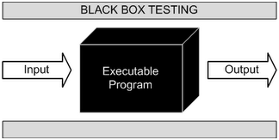
Black Box
known as Behavioral Testing, in which the internal structure/ design/ implementation of the item being tested is not known to the tester..

Slide 6
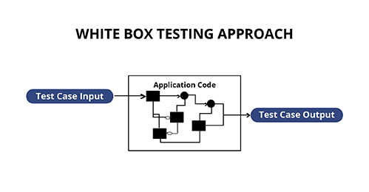
White Box
Also known as Clear Box Testing, Open Box Testing, Glass Box Testing, Transparent Box Testing, Code-Based Testing or Structural Testing, in which the internal structure/ design/ implementation of the program being tested is known to the tester.
The tester chooses inputs to exercise paths through the code and determines the appropriate outputs.

Slide 7
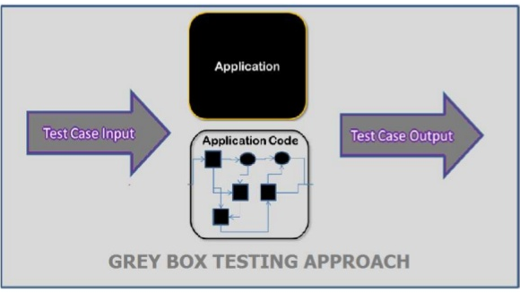
Grey Box
Is a combination of Black box Testing method and White Box Testing method. In Grey Box Testing, the internal structure is partially known. This involves having access to internal data structures and algorithms for purposes of designing the test cases.

Slide 8
Objectives
Determining the Code quality.
Code coverage, Failure modes
Implicit, Explicit, and Missing Requirements
Bug Fixing
Economics of Unit Testing

Slide 9
Challenges
Every change of requirements may change the behavior of the subject under test. Hence your integration test may break.
Not having enough Information/Resources on unit testing best practices
Creating proper initial conditions
The lack of appropriate documentation is one of the biggest challenges faced by testers
Last minute changes

Slide 10
Unit Testing Approaches
Test-Driven Development (TDD): in which unit testing is repeatedly done on source code. The concept is to "get something working now and perfect it later."
Acceptance Test Driven development (ATDD): an acceptance test confirms that an story is complete by matching a user action scenario with a desired outcome
Code Coverage Concepts : measure what percentage of code has been exercised by a test suite Coverage criteria is usually defined as a rule or requirement, which test suite needs to satisfy
Test Harness Development: test harness or automated test framework is a collection of software and test data configured to test a program unit by running it under varying conditions and monitoring its behavior and outputs
Top Down : In this approach testing is conducted from main module to sub module. if the sub module is not developed a temporary program called STUB is used for simulate the sub module.
Bottom Up: In this approach testing is conducted from sub module to main module, if the main module is not developed a temporary program called DRIVERS is used to simulate the main module.

Slide 11
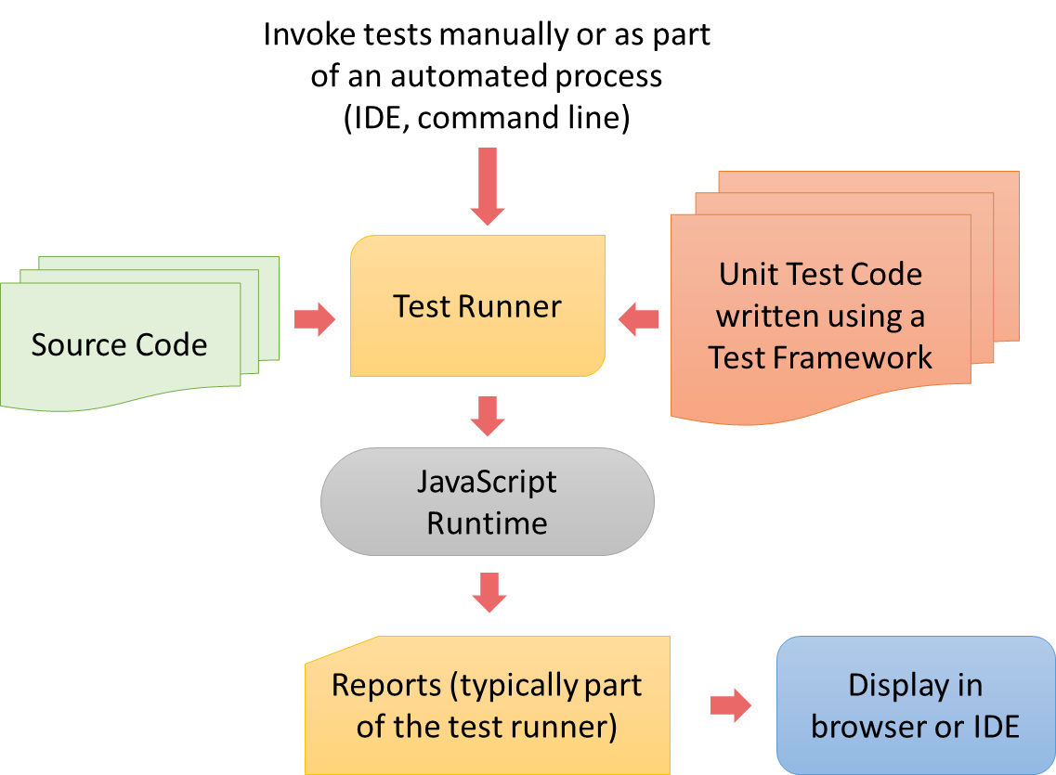
Unit Test Design

Slide 12
Best Practices
Always Write Isolated Test Cases
Test One Thing Only in One Test Case (Separation)
Use a Single Assert Method per Test Case
Use a Naming Convention for Test Cases (Self-descriptive)
Avoid the Expected Exception Tests
Structure All Test Cases
Use Descriptive Messages in Assert Methods
Measure Code Coverage to Find Missing Test Cases
Use Parameterized Tests
No test logic in production code
Test Case Modularity: Separation per business module
No loops and No conditional logic
Don’t print anything out in unit tests (Atomicity i.e.., Which should indicate whether the test is pass or fail)

Slide 13


